Slide 1
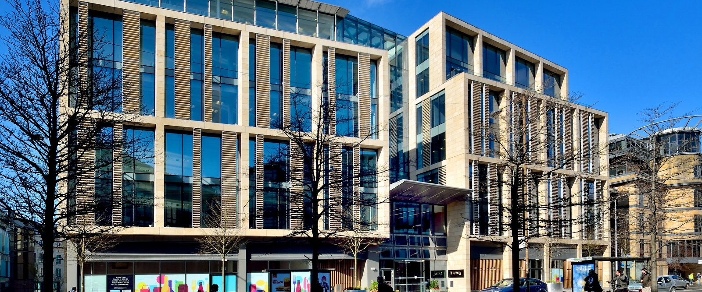

Law Society of Scotland
Annual Members’ Survey 2021
Report by Diffley Partnership by Mark Diffley Consultancy and Research Ltd

Slide 2
How much of a priority for the Society do you think each of the following services should be?

Slide 3
To what extent do you agree or disagree with the following statements

Slide 4
How much, if anything, would you say you know about the work of the Society?
Those who say they have a great deal or a fair amount of knowledge about the work of the society
Overall | 70%
Online | 63%
Telephone

Slide 5
High levels of awareness correspond to high levels of favourability of the work of the society (71%)
However levels of favourability have declined from 2019.
 | 2021 | 2019 | 2018
Very favourable | 13% | 18% | 17%
Fairly favourable | 58% | 72% | 70%
Neither favourable nor unfavourable | 17% | 2% | 7%
Fairly unfavourable | 8% | 6% | 7%
Very unfavourable | 3% | 1% | 1%

Slide 6
Half (51%) of members believe criminal legal aid provision is unsustainable

Slide 7
Members who practice legal aid tend to believe more often the provision of legal aid is unsustainable

Slide 8
‘The Journal’ is the preferred communications channel with over half (59%) of members utilising the resource

Slide 9
The Society provides support for trainee solicitors and solicitors who train them(trainers). Can you please tell me how much of a priority for the Society you think these should be?

Slide 10
Members tend to prefer model 3, which is similar to the current model of regulation

Slide 11
Regulatory compliance (64%) and access to the profession (60%) are the two biggest priorities of members

Slide 12
Members thought the Society’s communications during the coronavirus pandemic were good

Slide 13
Over half (59%) of members think the Society had a good response to the coronavirus pandemic

Slide 14
How would you rate the Society's regulatory support during the Covid-19 pandemic?

Slide 15
How would you rate the Society's financial support during the Covid-19 pandemic?

Slide 16
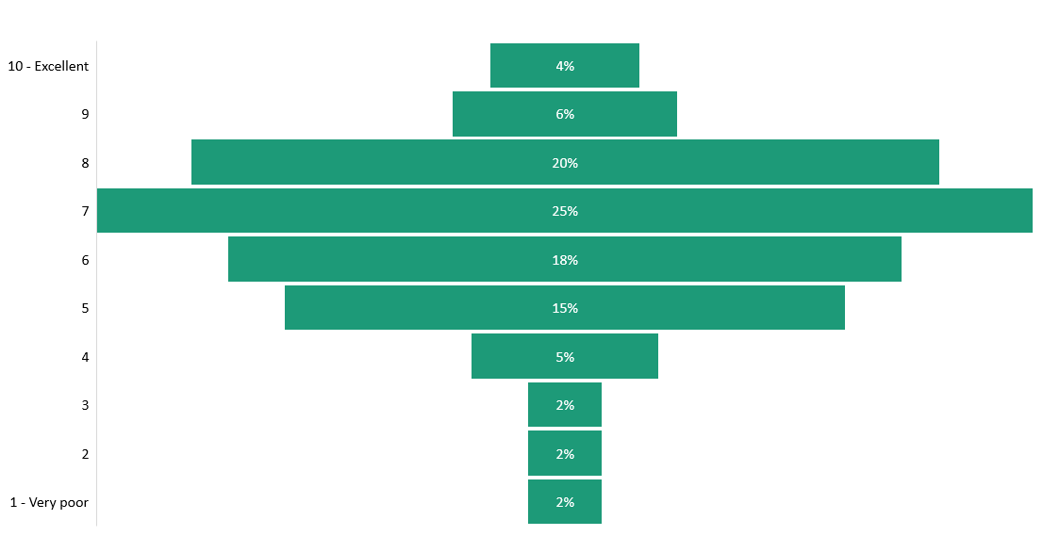
Overall, how you would rate the Society's response during the Covid-19 pandemic?
1 being very poor and 10 being excellent

Slide 17
For more information
Please contact our research team at research@lawscot.org.uk

