Slide 1
Legal Aid Heatmaps
James Ness

Slide 2
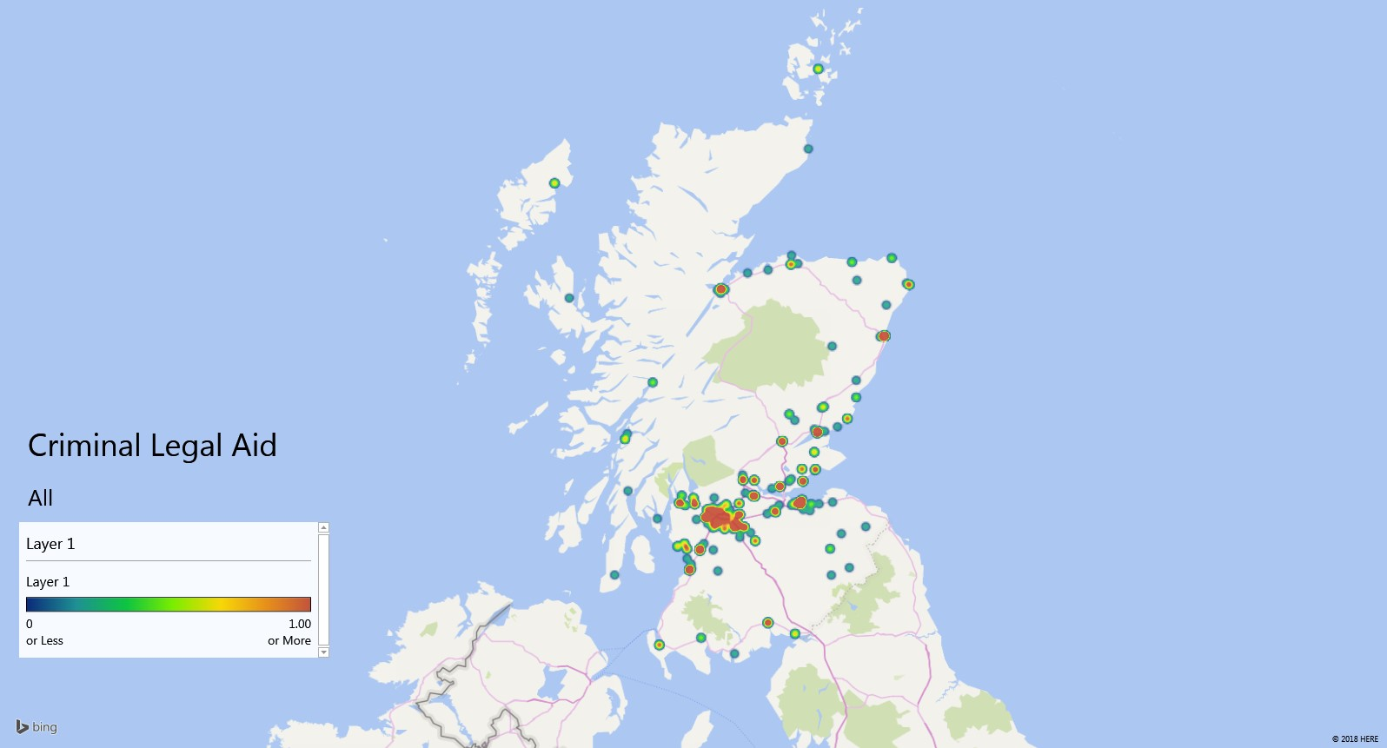
Legal Aid Heatmaps

Slide 3

Legal Aid Heatmaps

Slide 4
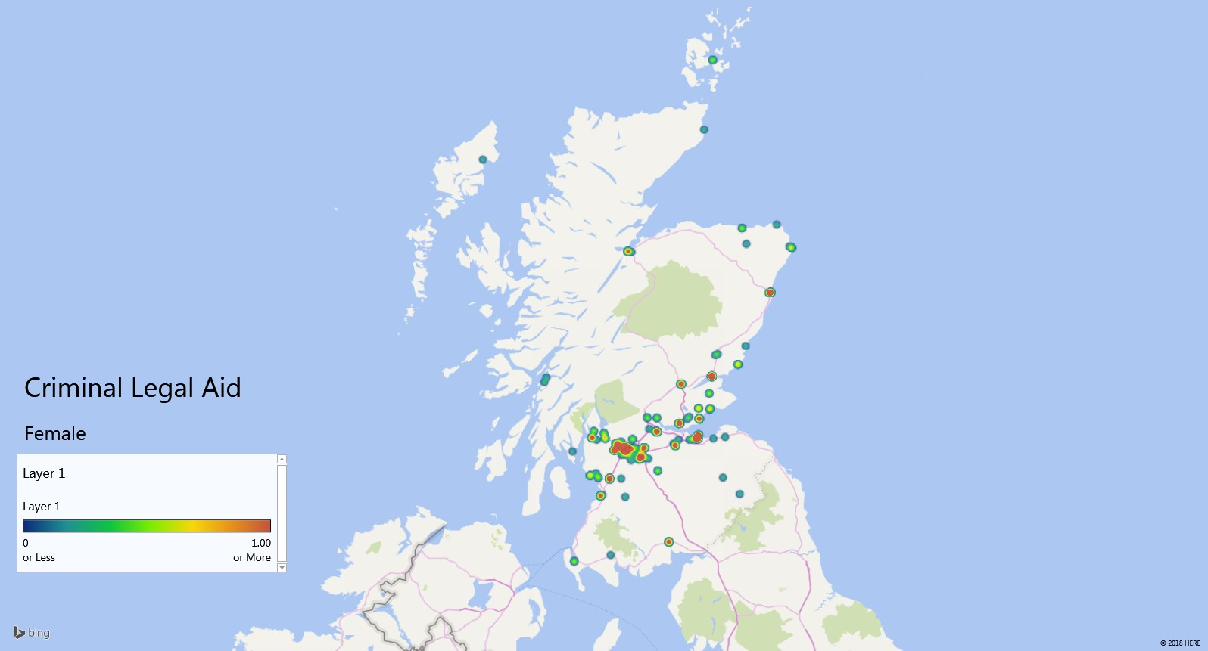
Legal Aid Heatmaps

Slide 5

Legal Aid Heatmaps

Slide 6
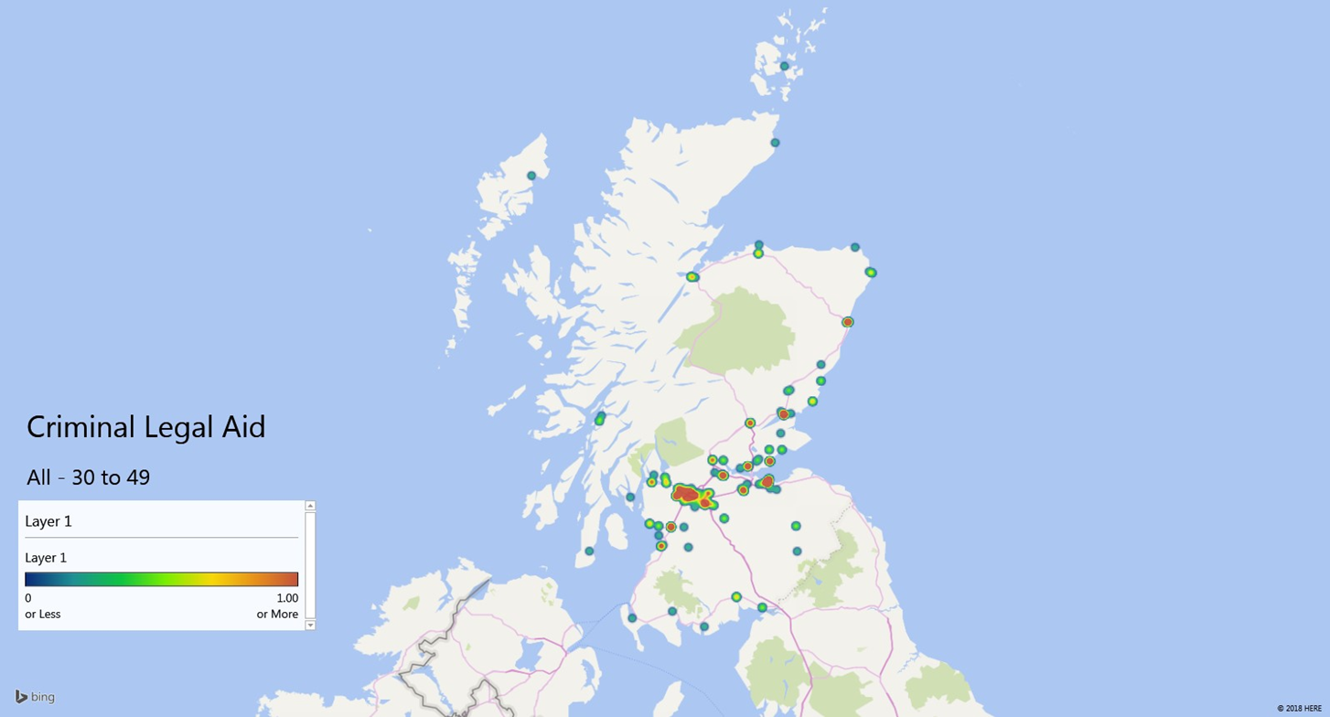
Legal Aid Heatmaps

Slide 7
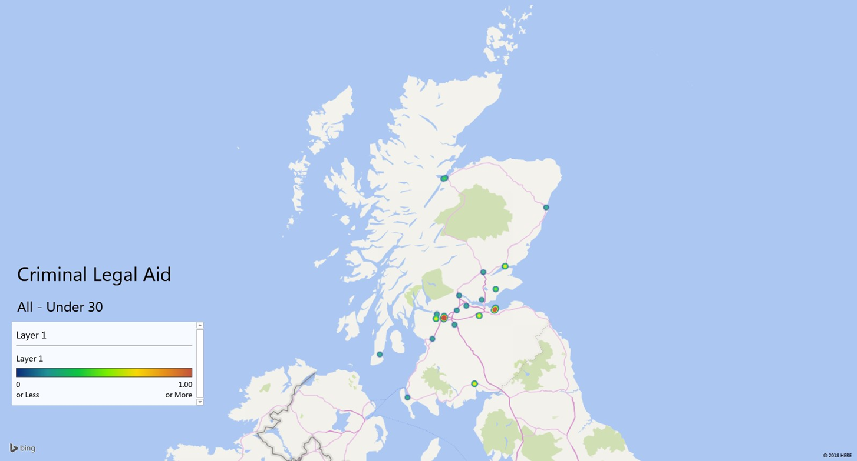
Legal Aid Heatmaps

Slide 8
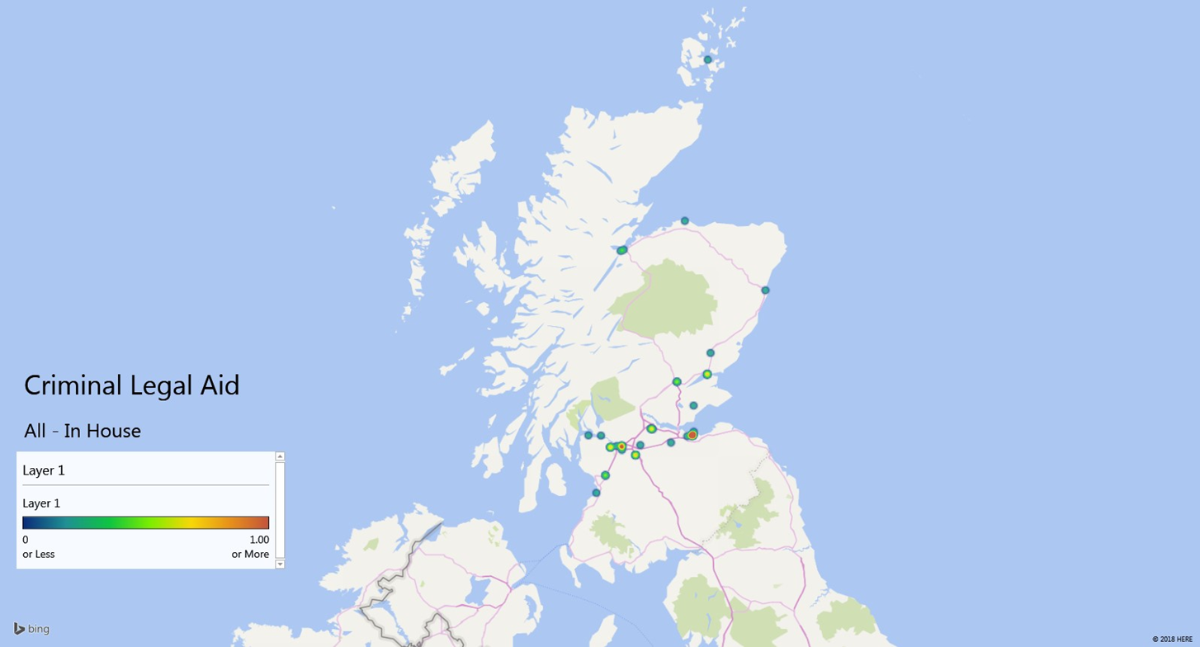
Legal Aid Heatmaps

Slide 9
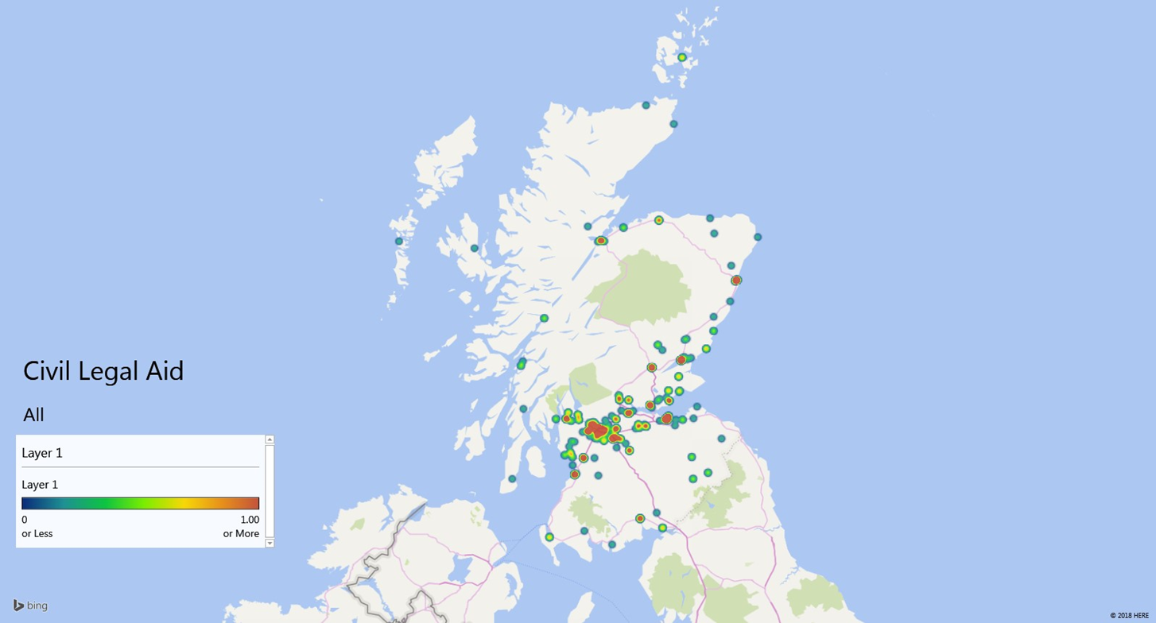
Legal Aid Heatmaps

Slide 10

Legal Aid Heatmaps

Slide 11

Legal Aid Heatmaps

Slide 12

Legal Aid Heatmaps

